Slide 1
Random Walk

Slide 2
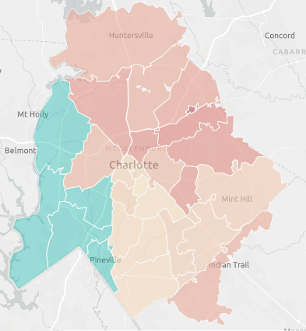
Mecklenburg County Access to Healthcare
Charlotte citizens who lack access to healthcare also experience:
Access to transportation
food insecurity
As of 2016, the median household income in charlotte was $61,000. however, in areas where patients lack access to healthcare the median household income was $28,000.

Slide 3
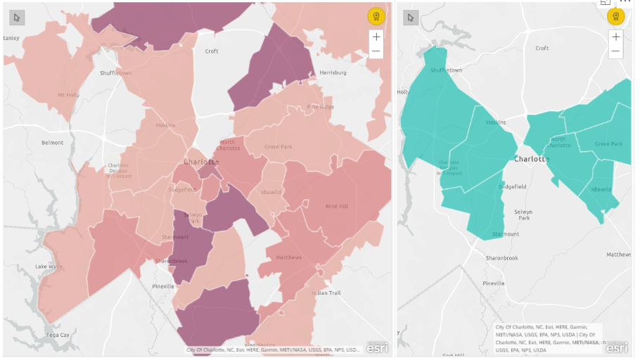
Locations of Physician Offices vs Zip Codes of Patients Lacking Access

Slide 4
Health Issues Plaguing Low Socioeconomic Communities in Charlotte
Health Output | Count
High Cholesterol | 435,975
High Blood Press | 411,866
Arthritis | 241,399
Mental Health | 162,059
Physical Health | 138,670
Diabetes | 122,228
Current Asthma | 116,832
COPD | 70,351
Cancer (except s | 68,704
Coronary Heart D | 64,386
Stroke | 37,754
Chronic Kidney D | 34,849
Prevention | Count
Pap Smear Test | 1,191,495
Mammography | 1,123,009
Cholesterol Scre | 1,046,572
Annual Checkup | 1,013,253
Taking BP Medica | 978,231
Core preventive | 975,267
Dental Visit | 912,890
Colorectal Cance | 894,908
Health Insurance | 231,318
Unhealthy | Count
Sleep <7 hours | 454,724
Obesity | 394,471
Physical Inactiv | 257,507
Binge Drinking | 245,343
Current Smoking | 231,388

Slide 5
Recommendations
Strategic plans to consider to provide all Charlotte residents access to care
Expand partnerships with nonprofits in the community to improve residents’ quality of life
Consider telehealth options to be available in schools
Mobile clinics to reach patients who have difficulties travelling to clinics and physician offices
Offer health education in the communities most impacted by lack of access
Develop a mobile app where patients can research health options available, have targeted messages on health education, can be triaged to the appropriate point of care

